Slide 1
Topic 4
Transform and Conquer
Prof. Hanan Elazhary
Main source: A. Levitin, Introduction to the Design and Analysis of Algorithms, 3rd edition

Slide 2
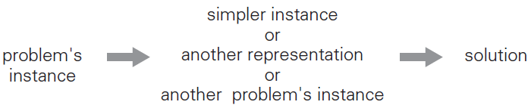
Transform and Conquer
This algorithm design strategy solves a problem by a transformation
to a simpler/more convenient instance of the same problem (instance simplification) – presorting and balanced search trees
to a different representation of the same instance (representation change)
to a different problem for which an algorithm is already available (problem reduction)

Slide 3
Presorting

Slide 4
Presorting
This is an example of instance simplification
Many problems involving lists are easier when the list is sorted
computing the median (selection problem, which is that of finding the k^{th} smallest element in a list of n numbers)
computing the mode
searching
checking if all elements are distinct (element uniqueness)
Additionally,
Topological sorting helps solve some problems for directed acyclic graphs (DAGs)
Presorting is used in many geometric algorithms (that deal with geometric objects such as points, lines, and polygons)
Presorting is a special case of preprocessing
With a pre-sorted array, the median can be conducted with efficiency O(1)
Notes:
- With a pre-sorted array, the median can be conducted with efficiency O(1)
In this case, sort the list: [1, 2, 3, 4, 5, 6, 7, 8, 9] to find the median, we are looking for the 5th smallest element (since ⌊9/2⌋=4 and lists are 0-indexed). Answer: The median :5

Slide 5
Presorting, Contd.
How fast can we sort?
Efficiency of algorithms involving sorting depends on efficiency of sorting
Theorem (see Sec. 11.2)
⎡log₂ n!⎤ ≈ n log₂ n comparisons are necessary in the worst case to sort a list of size n by any comparison-based algorithm
About n log₂ n comparisons are also sufficient to sort array of size n by mergesort

Slide 6
Example 1: Searching with Presorting
Problem: Search for a given key K in an array A[0..n-1]
Presorting-based algorithm
Stage 1: Sort the array by an efficient sorting algorithm (e.g., mergesort)
Stage 2: Apply binary search (considered best searching algorithm)
Efficiency (assuming most efficient sort)
Θ(n log n) + Θ(log n) = Θ(n log n) in the worst case
Θ(n log n) + O(log n) = Θ(n log n) generally
Good or bad?
Why do we have our dictionaries, telephone directories, etc. sorted?
with an already pre-sorted array, the search can be conducted with efficiency O(log n)

Slide 7
Example 2: Element Uniqueness with Presorting
Problem: whether all elements of an array of size n are unique
Presorting-based algorithm
Stage 1: Sort the array by an efficient sorting algorithm (e.g., mergesort)
Stage 2: Scan the array to check pairs of adjacent elements
Efficiency (assuming most efficient sort)
Θ(n log n) + Θ(n) = Θ(n log n) in the worst case
Θ(n log n) + O(n) = Θ(n log n) generally
Remember that in Brute force algorithm, we compare all pairs of elements, and the efficiency is in O(n²)
Another algorithm? Hashing, which works well on average
with an already pre-sorted array, the element uniqueness problem can be solved with efficiency O(n)

Slide 8
Searching

Slide 9
Searching
Problem: Given a set S of keys and a search key K, find an occurrence of K in S, if any
Searching must be considered in the context of
File size (internal vs. external)
dynamics of data (static vs. dynamic)
Dictionary (dynamic data) operations
find (search)
insert
delete
Notes:
external as in cloud?

Slide 10
Searching, Contd.
Taxonomy of searching algorithms
List searching (good for static data)
sequential search
binary search
interpolation search
Tree searching (good for dynamic data)
binary search trees
binary balanced search trees: AVL trees, red-black trees
multiway balanced search trees: 2-3 trees, 2-3-4 trees, B-trees
Hashing (good on average case)
open hashing (separate chaining)
closed hashing (open addressing)
Notes:
Hashing is discussed in space-for-time. It is an example of representation change?

Slide 11
Binary Search Tree
Binary search tree
a number assigned to any vertex is
larger than all the numbers in its left subtree and
smaller than all the numbers in its right subtree
inorder (left subtree, root, right subtree) traversal produces sorted list
K
<K
>K
5
3
10
1
7
12
binary search tree property
9
Example: 5, 3, 1, 10, 12, 7, 9
Notes:
Binary search tree is ordered

Slide 12

Binary Search Tree, Contd.
It can be proved that the height of a binary search tree is as follows
based on whether the tree is balanced or unbalanced
and the height average (random files) is about 3 log₂ n
Notes:
3log₂​n. This approximation considers that the tree remains relatively balanced over random insertions and deletions, even if it is not perfectly balanced.

Slide 13
Binary Search Tree, Contd.
The basic operations are
Searching – straightforward (recursively)
Insertion – search for key, insert at leaf where search terminated
Deletion (3 cases)
deleting key at a leaf
deleting key at node with single child
deleting key at node with two children
The three operations depend on the tree height
worst case efficiency Θ(n)
average case efficiency Θ(log n)
Notes:
More precisely, the number of key comparisons needed for a search in a binary search tree built from n random keys is about 2ln n ≈ 1.39 log₂ n

Slide 14
Binary Search Tree, Contd.
Attractiveness of binary search tree is marred by the bad (linear) worst-case efficiency
Two ideas to overcome it are as follows
Balanced binary search trees - rebalance binary search tree when a new insertion makes the tree too unbalanced - examples of instance simplification
AVL trees
red-black trees
Multiway balanced search tree – allow more than one key in each node, but is perfectly balanced - examples of representation change
2-3 trees
2-3-4 trees
B-trees

Slide 15
AVL Trees
An AVL tree is a self-balancing binary search tree – balanced binary search tree
It is an example of instance simplification
An AVL tree is
a binary search tree in which
the difference between the heights of the left and right subtrees of every node (balance factor) never exceeds 1 (either 0 or +1 or −1)
with the height of an empty tree defined as -1
Notes:
AVL trees were named after their inventors, Adelson-Velskii and Landis.

Slide 16
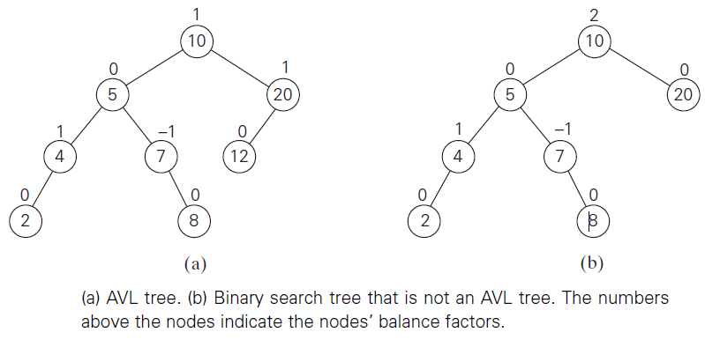
AVL Trees, Contd.
node 10 in (a): (left subtree height 3) – (right subtree height 2) =3-2= 1

Slide 17
AVL Trees, Contd.
If an insertion of a new leaf makes an AVL tree unbalanced, we transform the tree by a rotation
A rotation in an AVL tree is a local transformation of its subtree rooted at a node whose balance has become either +2 or −2
If there are several such nodes, we rotate the subtree rooted at the unbalanced node that is the closest to the newly inserted leaf
There are 4 rotation types
single right rotation (R-rotation) – in left left case
single left rotation (L-rotation) – in right right case
double left-right rotation (LR-rotation) – in left right case
double right-left rotation (RL-rotation) – in right left case

Slide 18
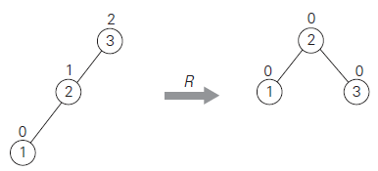
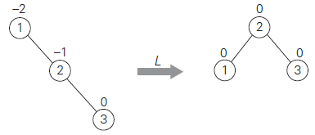
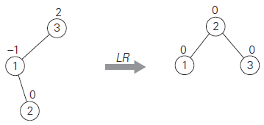
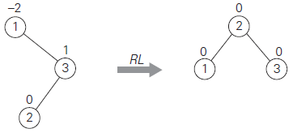
AVL Trees, Contd.
L
R
in left-left case: in right-right case:
rotate the first left (R(3)) rotate the first right (L(1))
R
L
L
R
in left-right case: in right-left case:
rotate the right (L(1)) and then the left (R(3)) rotate the left (R(3)) and then the right (L(1))

Slide 19
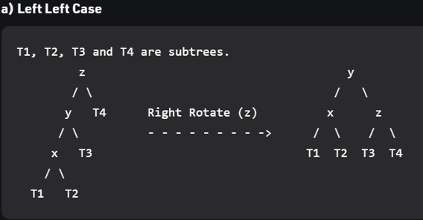
AVL Trees, Contd.
General Right rotation

Slide 20
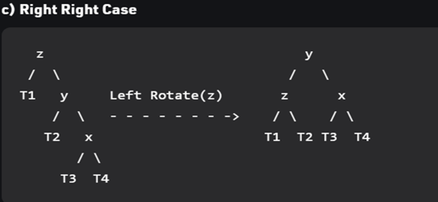
AVL Trees, Contd.
General Left rotation

Slide 21
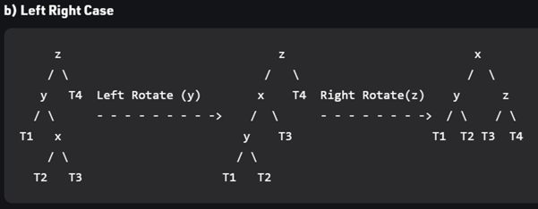
AVL Trees, Contd.
General Left-Right rotation

Slide 22
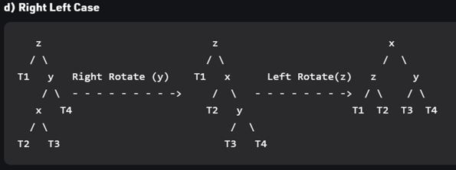
AVL Trees, Contd.
General Right-Left rotation

Slide 23
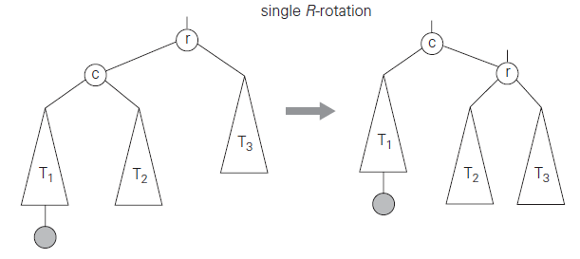
AVL Trees, Contd.
Notice how we handled abandoned branches in the general case (R-rotation for example)
When R-rotation is applied on the link between r and C, node r becomes the right-child of node C leaving T2, which was the right-child of C before rotation, abandoned
This also leaves node r without a left-child
T2 becomes left child of r and since T2 values are smaller than r, this is a legal operation

Slide 24
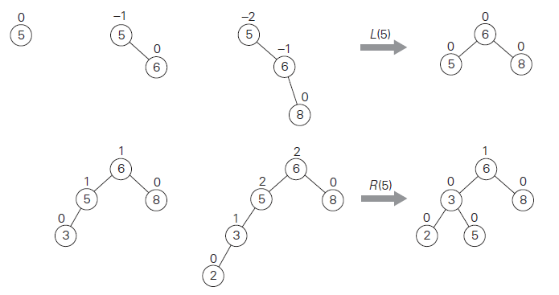
AVL Trees, Contd.
Constructing an AVL tree example
in right-right case, rotate the first right (L) at unbalanced (5)
in left-left case, rotate the first left (R) at unbalanced (5) which is closer to inserted 2

Slide 25
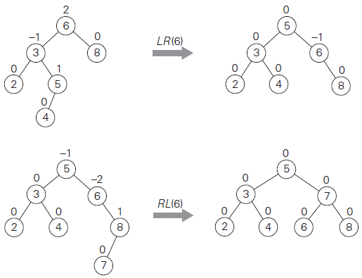
AVL Trees, Contd.
R
L
in left-right case, rotate the right (L) and then the left (R) at unbalanced (6)
L
R
in right-left case, rotate the left (R) and then the right (L) at unbalanced (6)

Slide 26

AVL Trees, Contd.
Analysis of AVL tree
average height is 1.01 log₂n + 0.1 for large n (found empirically)
Search and insertion are in O(log n)
Deletion is more complicated but is also in O(log n)
Disadvantages
frequent rotations
Complexity (the need to maintain balances for its nodes)
A similar idea to AVL trees is red-black trees (tolerates the height of one subtree being twice as large as that of the other subtree of the same node)
Notes:
These drawbacks have prevented AVL trees from becoming the standard structure for implementing dictionaries.
N(h-1) + N(h-2) ≤ N(h)

Slide 27
Multiway Search Trees
Multiway search tree – a search tree which allows more than one key in each node
An n-node contains n-1 ordered keys and has n children
such that its keys divide the entire key range into n intervals pointed to by the node’s links to its n children
and thus, every node in a classical binary search tree is a 2-node
k₁ < k₂ < … < k_{n-1}
Different types of multiway search trees are modifications of this architecture
< k₁
[k₁, k₂)
≥ k_{n-1}

Slide 28
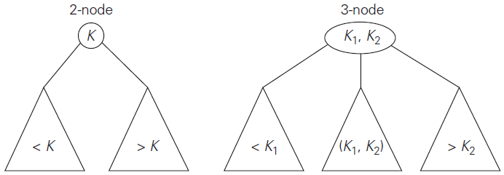
2-3 Trees
A 2-3 tree is a multiway balanced search tree
It is an example of representation change
Specifically, a 2-3 tree is a search tree that
may have 2-nodes and 3-nodes
is height-balanced (all leaves are on the same level)

Slide 29
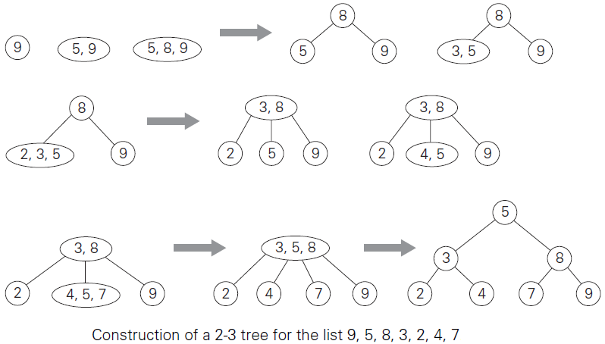
2-3 Trees, Contd.
A 2-3 tree is constructed
by successive insertions of keys into leaves of the tree
and if the leaf become a 4-node (has 3 keys), it’s split into two with the middle key promoted to the parent
and in case of inserting a third key in the root, a new root is created to accept the middle key: can lead to several other node splits
9 5 8 3
2 4
7
29

Slide 30
2-3 Trees, Contd.
Analysis of 2-3 tree
log₃ (n + 1) - 1 ≤ h ≤ log₂ (n + 1) - 1
Search, insertion, and deletion are in Θ(log n)
The idea of 2-3 tree can be generalized by allowing more keys per node (2-3-4 trees, B-trees)
30
Notes:
in both the worst and average cases

Slide 31
Questions?

